Slide 1
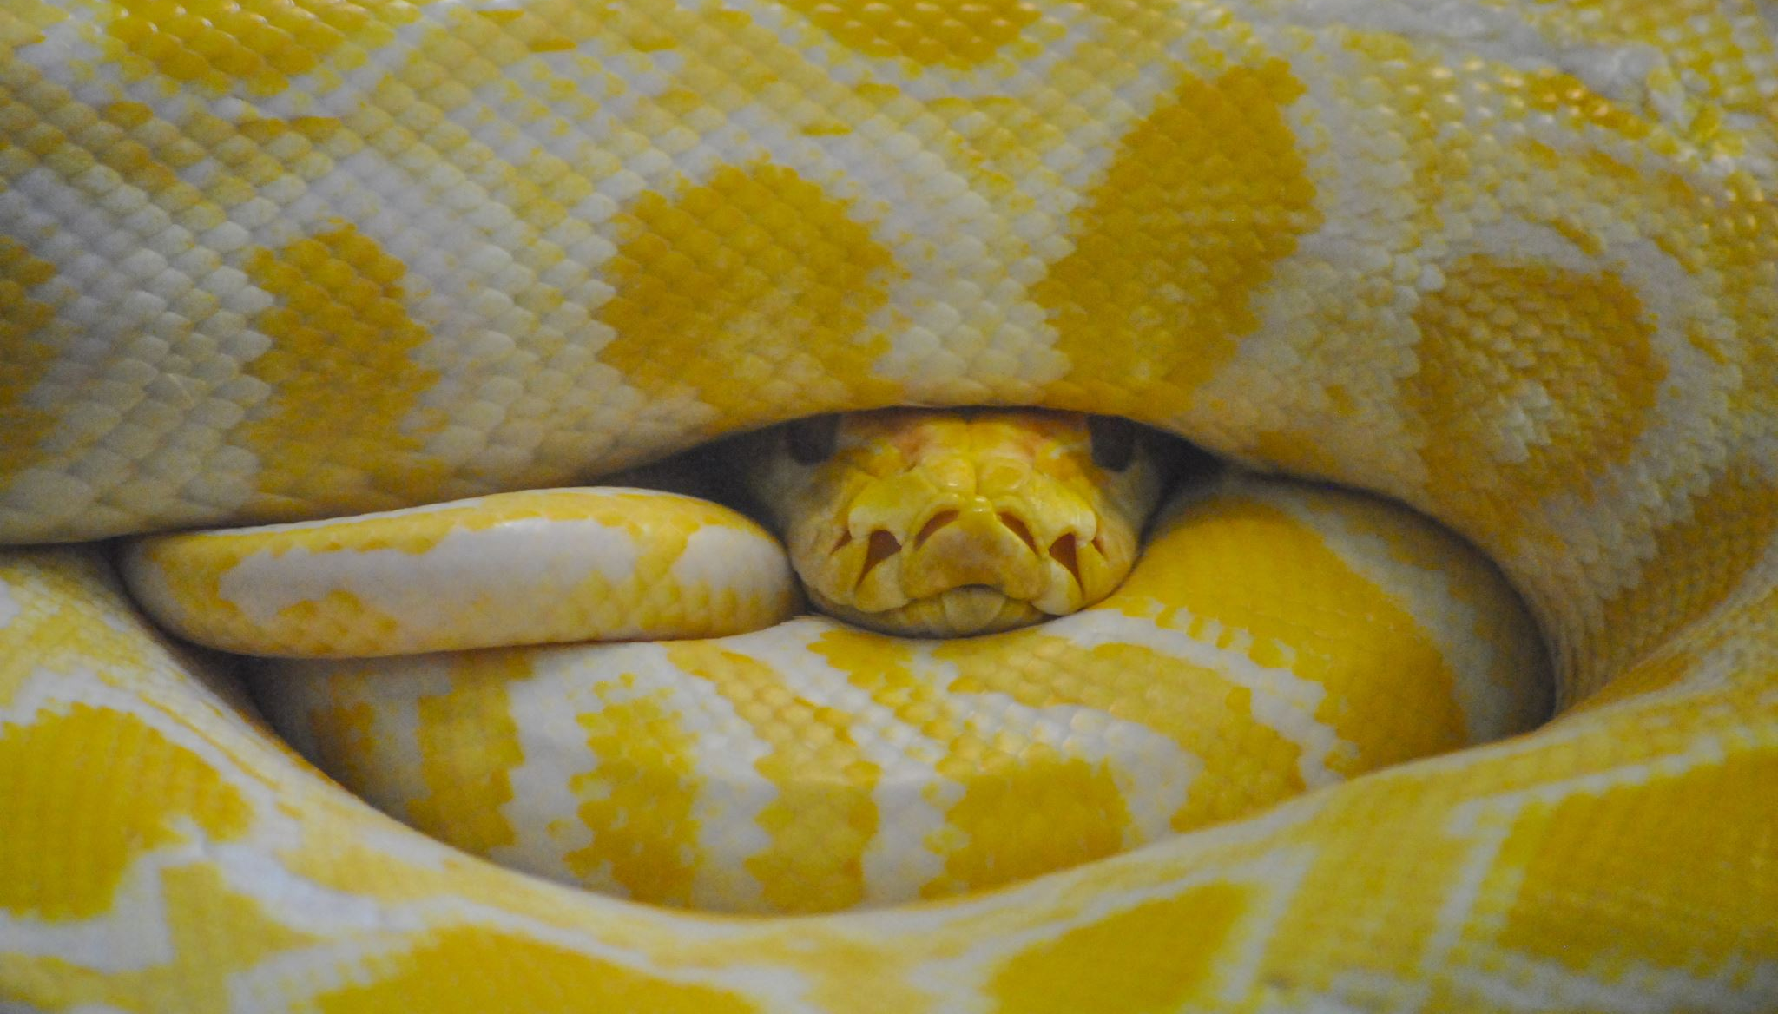
Rock, Paper, Python!
A Rock Paper Scissors Game
Created By: Christopher Michaels

Slide 2
Features:
Normal Mode and Challenge Mode.
Selectable number of rounds to play.
Score history saved to a text file.
Inputs to save player name, score and game mode.

Slide 3
Objective
Create a rock, paper, scissors game in python that includes a loop and an if statement.
I wanted to add user inputs such as name, number of rounds, and option to pick different difficulties.
I also wanted to create a scoring system that could include a leaderboard and rank past players accordingly.

Slide 4
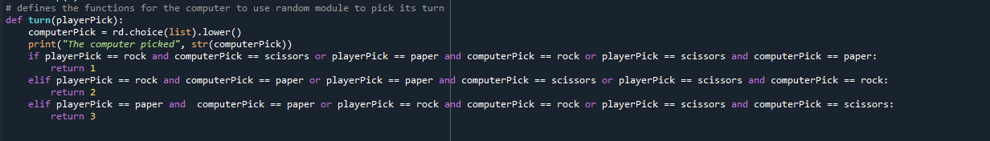
What I did to Accomplish The Objectives
Using random module, I was able to allow the computer to make a random pick each turn, and then compare it to the player input.

Slide 5
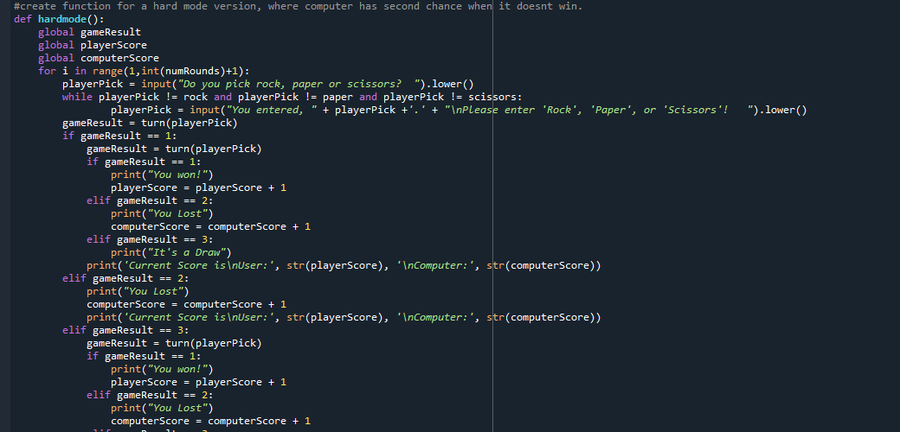
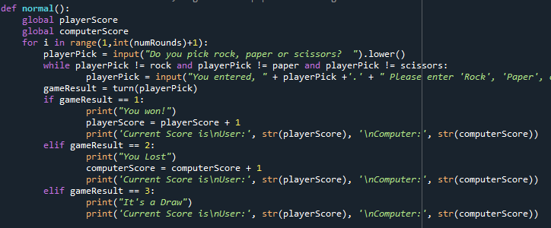
Using functions, I made normal and challenge game modes

Slide 6
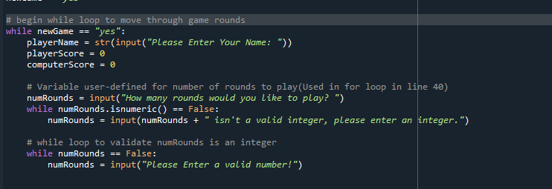
Takes an input from the user to set their name and the number of rounds to play

Slide 7
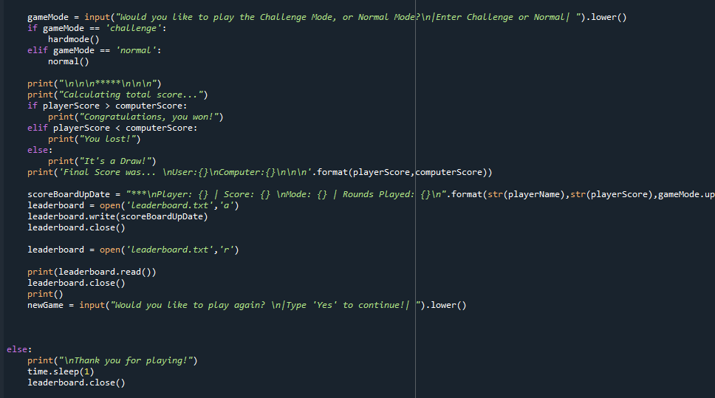
Then, calls a functions based off what game mode is selected, and repeats within the loop until the user is done playing.

Slide 8
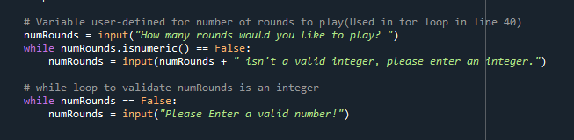
Uses a while loop and .isnumeric to validate the input of number of rounds is a number.
Little Details
I tried my best to pay attention to the little things, such as if a user misspelled a word, or didn’t enter with correct capitalizations.
There are a few precautions built in, so that if the wrong word or wrong format is used, it won’t crash the program.
Uses a while loop to see if the user input is “rock”, “paper” or “scissors”

Slide 9
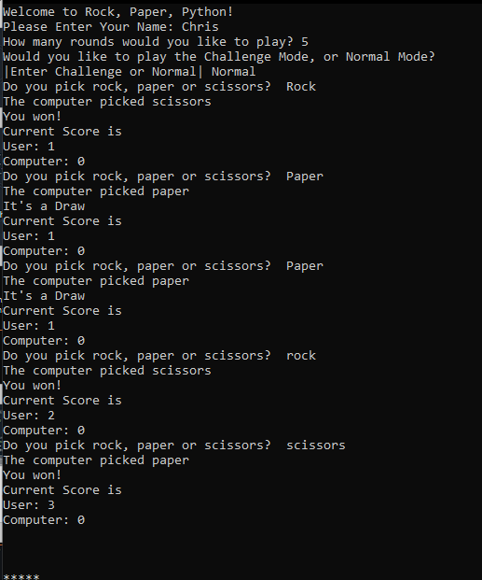
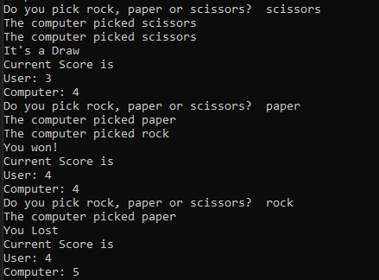
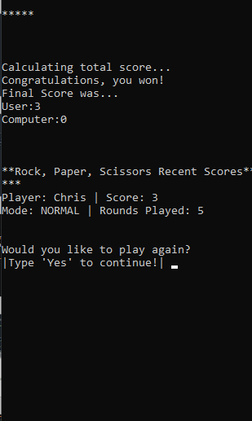
This was a very fun project, and I enjoyed pushing myself to add more. The challenges to make things work that I knew could work but had to figure out were wonderful.

Slide 10
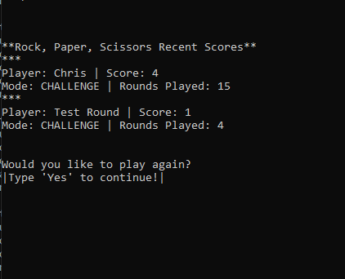
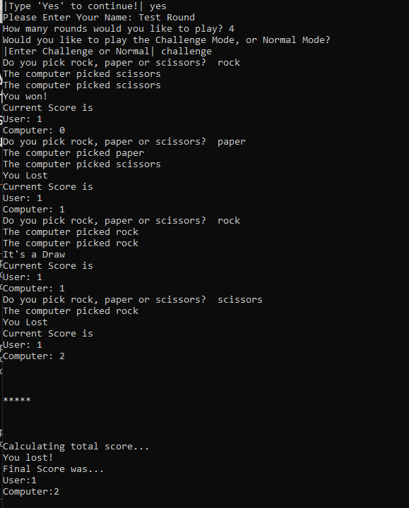

Slide 11
Thank you for playing and hope you had fun!

